Slide 1

AWS Secrets Manager
Effective Management

Slide 2

Introduction
AWS Secret Manager is a secure service that helps manage and retrieve credentials and secrets. It simplifies the process of storing, rotating, and monitoring sensitive information such as API keys, passwords, and certificates. This presentation explores the benefits and functionalities of AWS Secret Manager.

Slide 3
Key Features and Benefits
Key features include automatic secret rotation, fine-grained access control, and audit logging. These features offer businesses improved security, reduced overhead in secret management, and the ability to easily integrate with AWS services for seamless operations.

Slide 4

AWS Secret Manager Use Cases
AWS Secret Manager is utilized in various scenarios, including securely managing database credentials, access keys for APIs, and SSH keys for servers. It is essential for organizations aiming to enhance security practices and ensure compliance with regulations.

Slide 5

Creating and Storing Secrets
With AWS Secret Manager, users can easily create and store secrets in a secure manner. This process includes rotating and retrieving secrets using simple API calls, significantly reducing manual overhead and enhancing data protection.

Slide 6
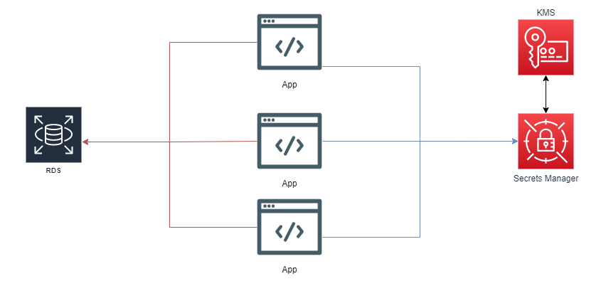
Access Management and Permissions
Access management is vital for safeguarding sensitive information. AWS Secret Manager allows for detailed permission settings, enabling organizations to enforce least privilege access and maintain robust security protocols.

Slide 7
Best Practices for Security
Implementing best practices when using AWS Secret Manager is crucial. Regularly rotate secrets, use strong authentication mechanisms, and monitor access logs to ensure the integrity and security of your sensitive data.

Slide 8

Conclusions
In conclusion, AWS Secret Manager streamlines the management of secrets, offering significant benefits in security and efficiency. Utilizing this service positions organizations to better protect sensitive information and comply with industry standards.

